Slide 1


CANTEEN MANAGEMENT
BY:-
NAME:- DETROJA KUNJ
ENROLL:- 21002170210016
BATCH:- C-2
BRANCH:- it

Slide 2
INTRODUCTION
ITS PROJECT OF CANTEEN MANAGEMENT
YOU CAN ORDER FOOD THROUGH OUR WEBSITE
YOU CAN KNOW WHICH IS BEST SELLER ITEM ON WEBSITE
THERE ARE VARIOUS CUISINES LIKE INDIAN,CHINESE,ITALIAN, ETC
ONLY VEG. FOOD IS AVAILABLE

Slide 3
TECHNOLOGY USED
HTML
CSS
BOOTSTRAP
JAVASCRIPT

Slide 4
FUNCTIONALITY
THERE ARE 4 DIFFERENT HTML FILES HOME ,ORDER,HELP,LOGIN
HOME .HTML :-TO CREATE HOME PAGE OF MY WEBSITE
ORDER.HTML:- TO DISPLAY AVAILABLE FOOD AND ORDER FOOD
HELP.HTML:- TO SOLVE QUERY OF CUSTOMERS
LOGIN.HTML :- FOR LOGIN

Slide 5
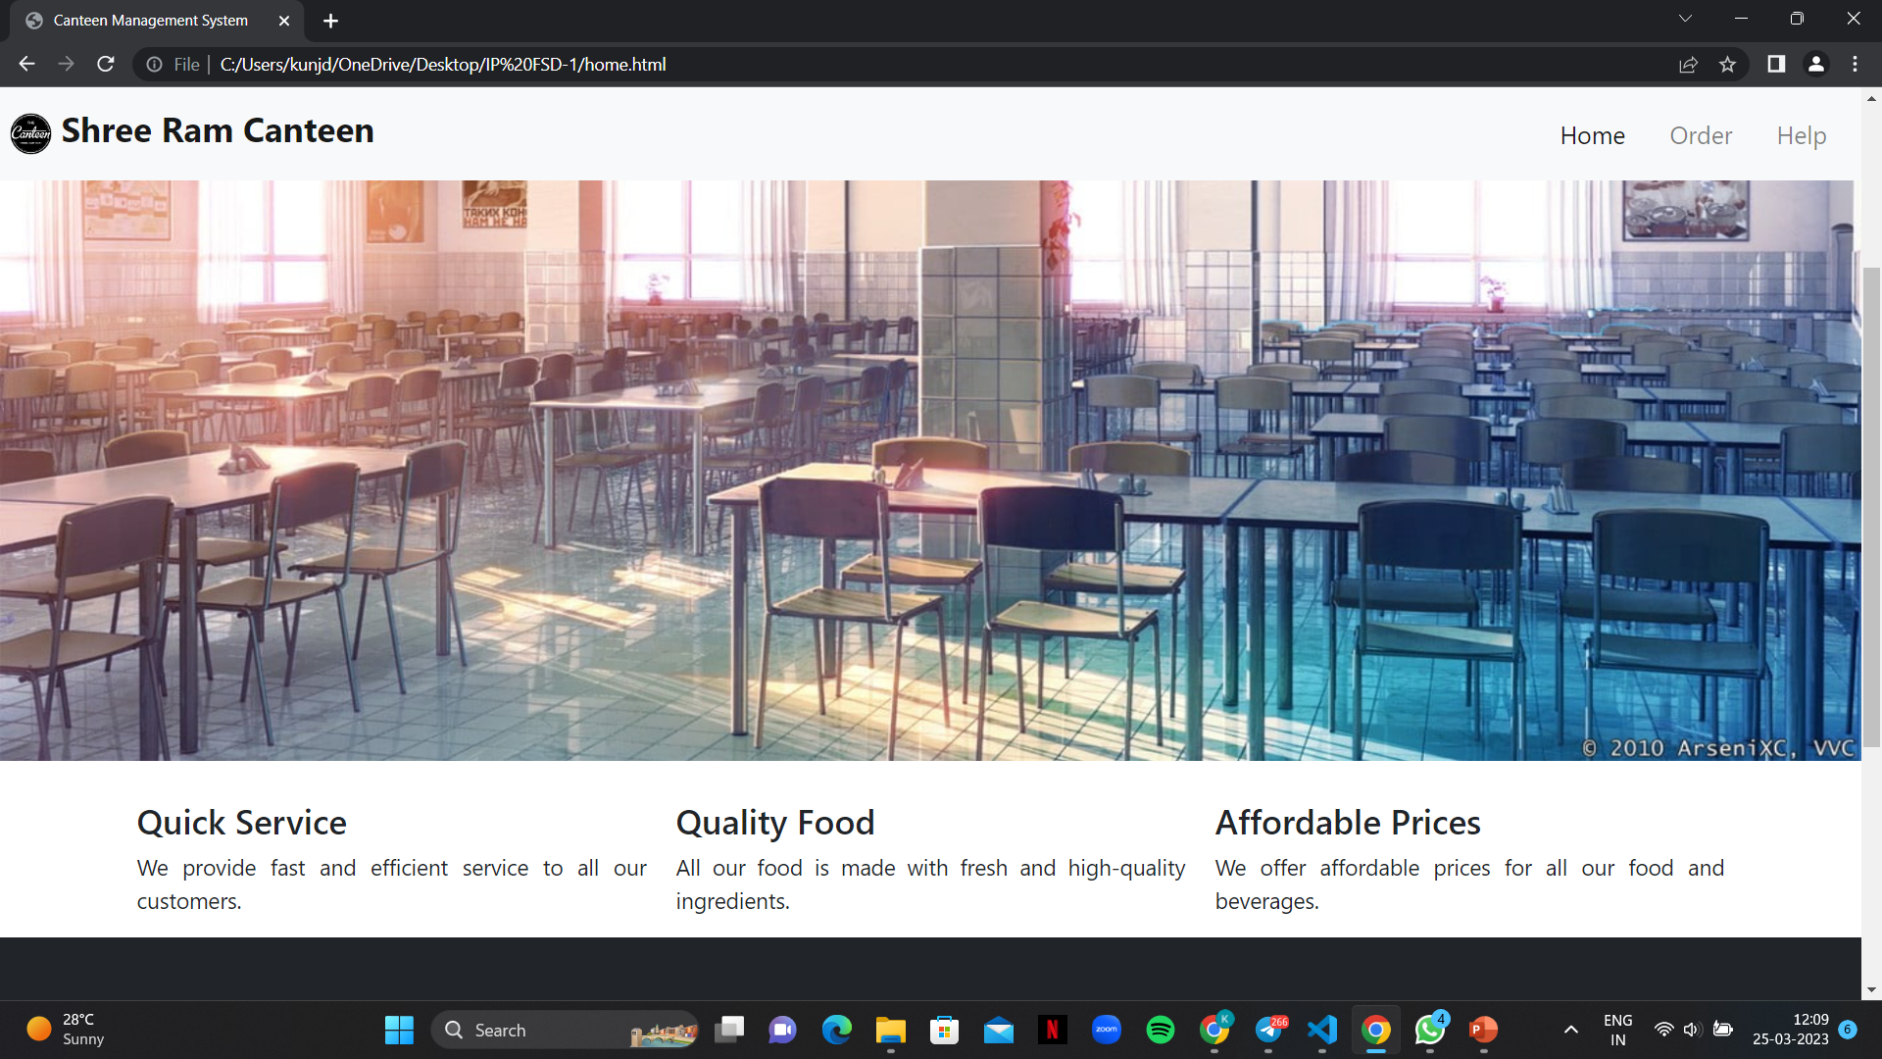
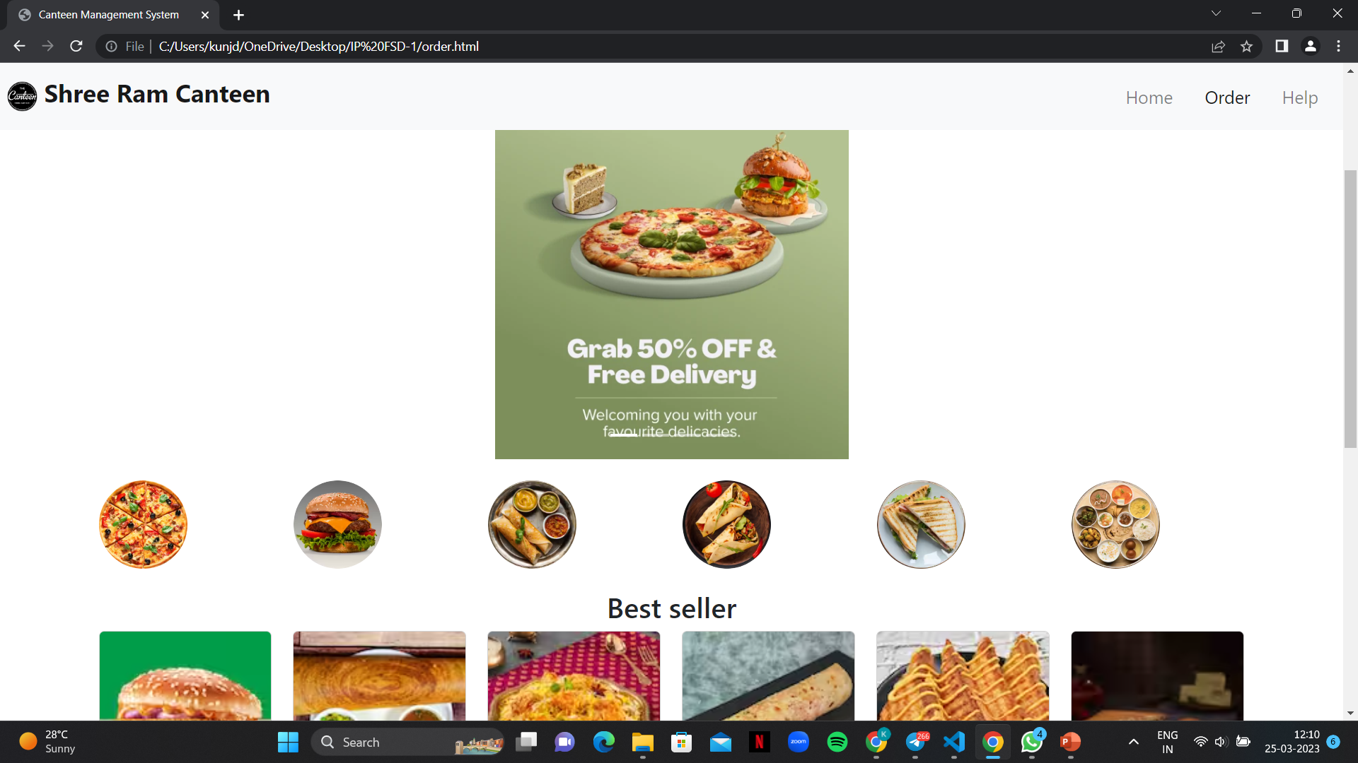
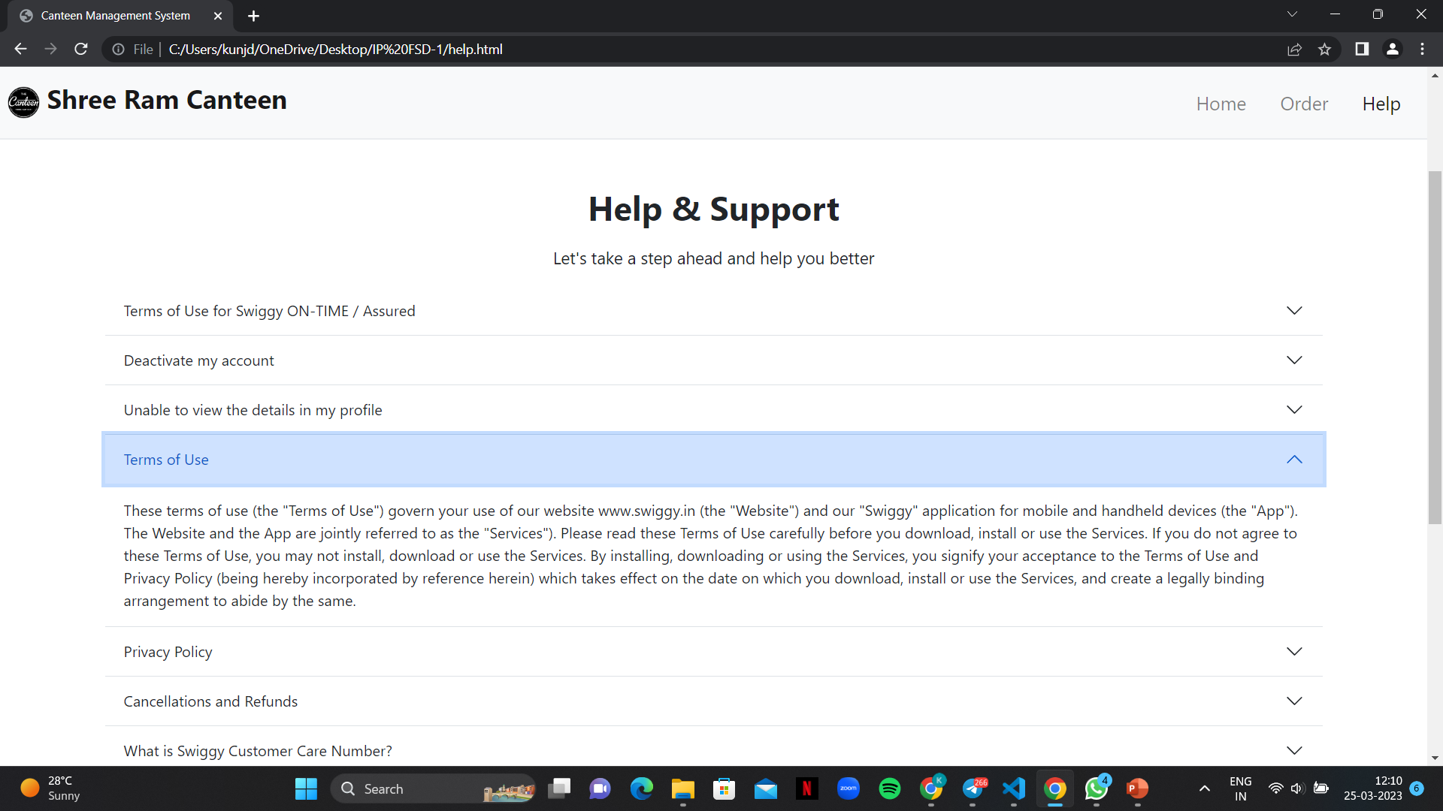
OUTPUT

Slide 6
THANK YOU

